Slide 1
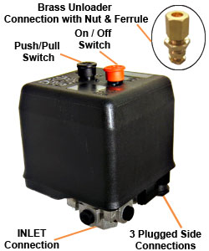
NEMA Italian Pressure Switch Starter - built-in Overload
Bar | PSI | AMPS @ 400V | KW | Code
11 | 160 | 4 | 1.5 | NE-AZ8602
11 | 160 | 6 | 2.2 | NE-AZ8603
11 | 160 | 10 | 3 & 4 | NE-AZ8604
11 | 160 | 16 | 5.5 | NE-AZ8605
11 | 160 | 16 | 7.5 | NE-AZ8606
11 | 160 | 23 | 23 | NE-AZ8607
- maximum AMPS 23A
- maximum Volts 500V
- unloader port
- adjustable differential
- on-off buttons
- pressure switch starter
- 1/4" BSP inlet
- IP42 protection rating

